Slide 1
Agave Inulin Presentation

Slide 2
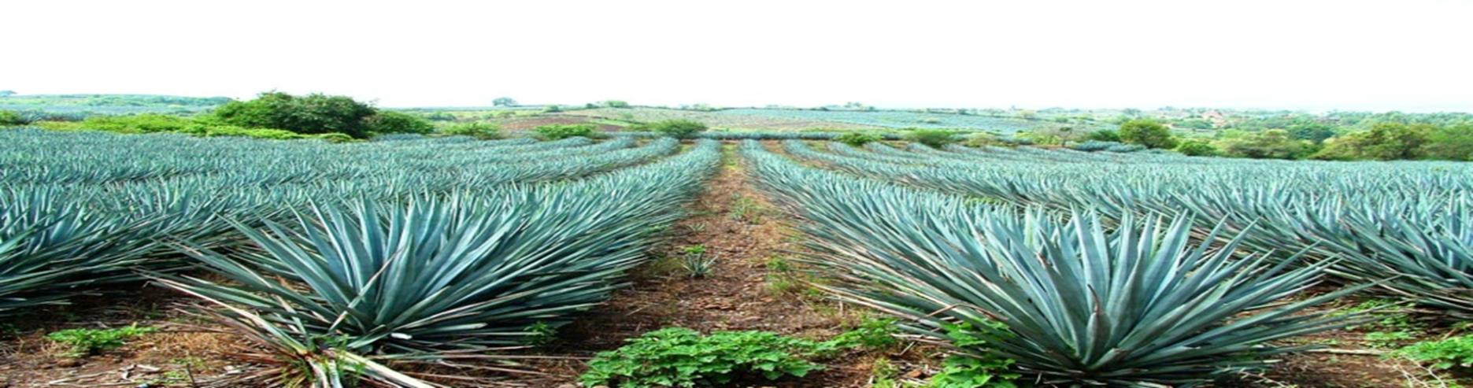
About the raw material
Mexico is considered the center of origin and biodiversity of the agave genus, due to the taxonomic diversity within its territory. Of the 310 species reported, about 272 can be found here. The most important species is the Agave Tequilana Webber.

Slide 3
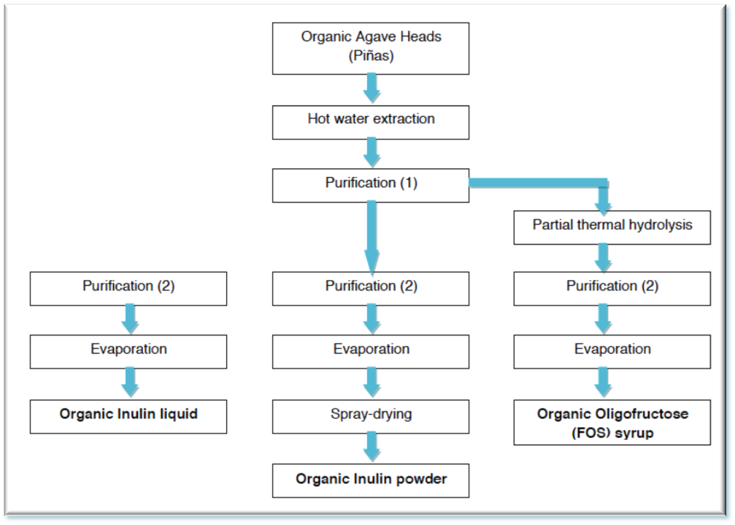
Production process of agave inulin and FOS

Slide 4
Agave inulin (powder/liquid)key attributes
Has FOS (oligofructose) properties
Contains both short and long chain fructans.
Helpful in feeding good bacteria (bifodobacteria and lactobacillus) from the beginning to the end of the bowel system.
Low-glycemic
Lower hygroscopicity vs. other inulins
Used as a fat replacement or partial sugar replacement.

Slide 5
Agave inulin key attributes (con’t)
Bland neutral to sweet taste, without any off-flavor or aftertaste. Therefore combines easily with other ingredients without modifying delicate flavors.
Enhanced solubility provides improved sensory attributes (e.g. taste and tongue sensation)
Works in synergy with most gelling agents.
Improves stability of foams and emulsions, such as aerated desserts, ice creams, table spreads and sauces. It can therefore replace other stabilizers in different food products.

Slide 6
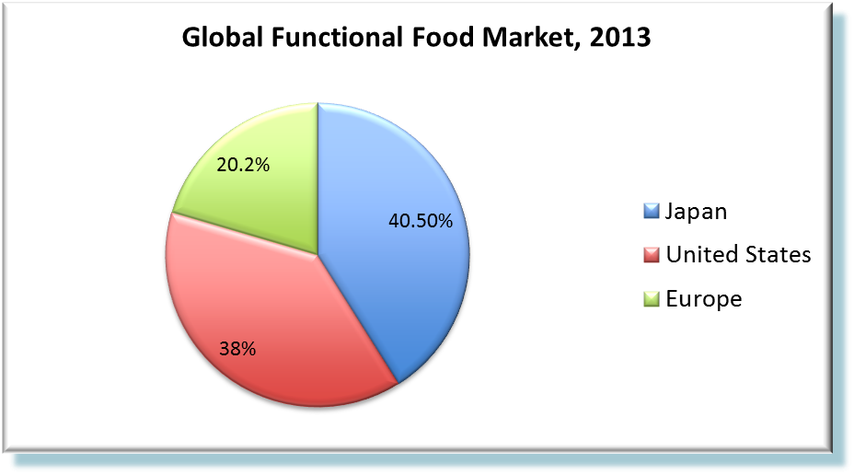
Functional food trend
A “Functional Food” is a conventional/everyday food or food ingredient that is naturally occurring in foods and provides proven beneficial effect(s) on target functions beyond nutritive value/basic nutrition. It also provides enhanced well-being and health and/or reduced disease risk. (Source: functional Food Science in Europe (FUFOSE))
The estimated the global market for functional foods was worth $43.27 billion in 2013, an increase in value terms of 26.7% compared with 2009. *
The U.S. market has grown by more than 29% in the years since 2009.*
The global market for functional waters in 2013 grew by 8.5% to $6.5 billion*
(Source: Leatherhead, 2014)

Slide 7
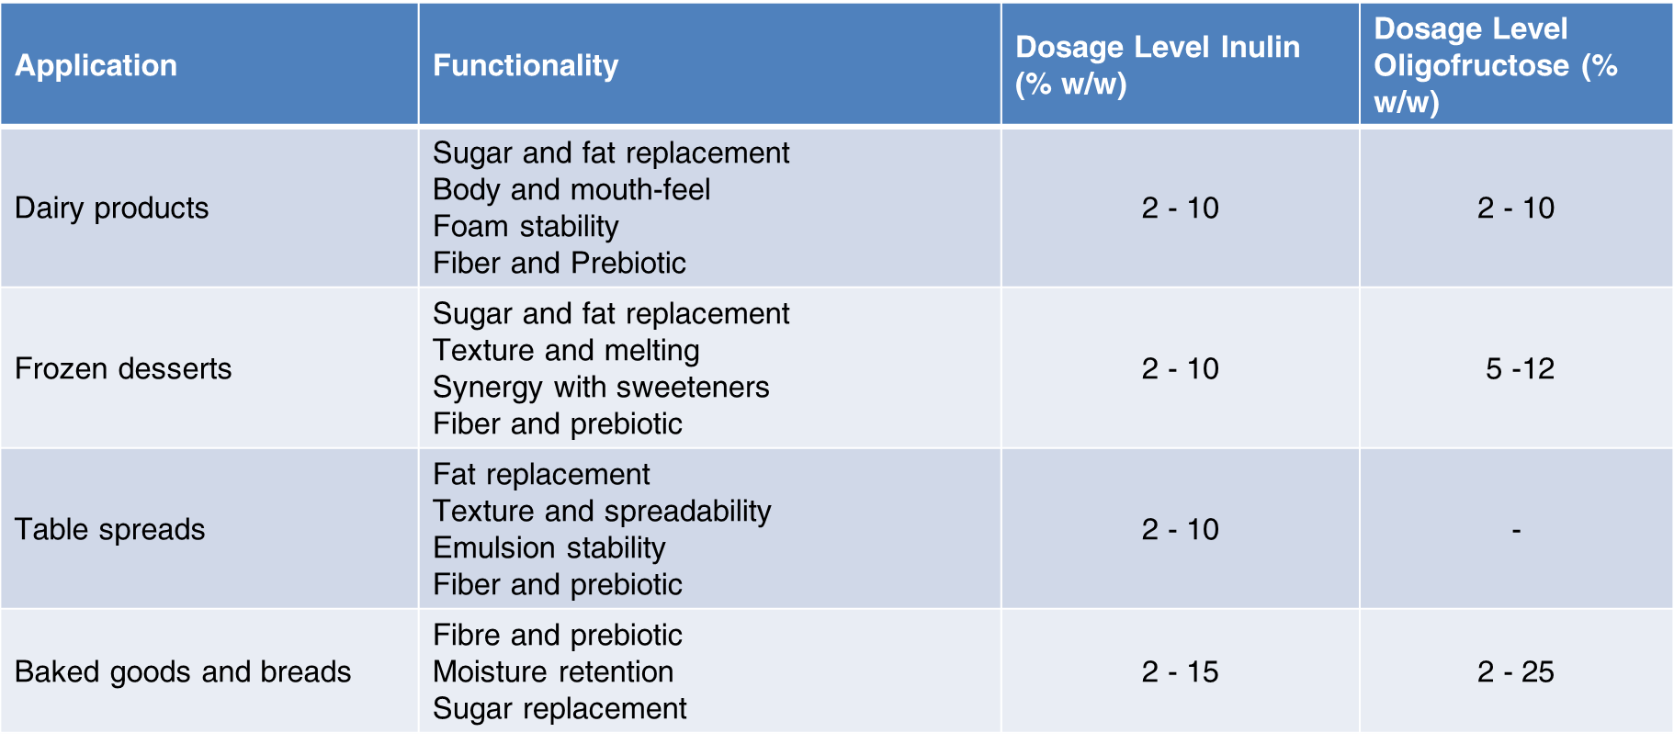
Agave inulin (Liquid/Powder) and FOS syrup industrial applications

Slide 8
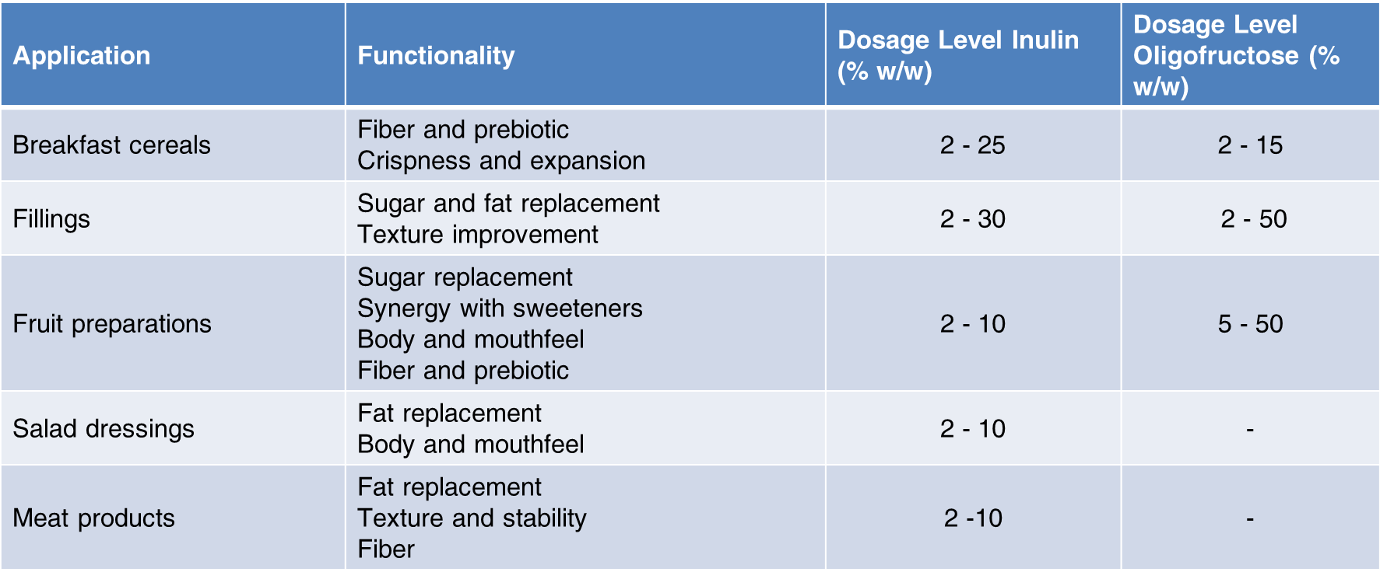
Agave inulin (Liquid/Powder) and FOS syrup industrial applications

Slide 9
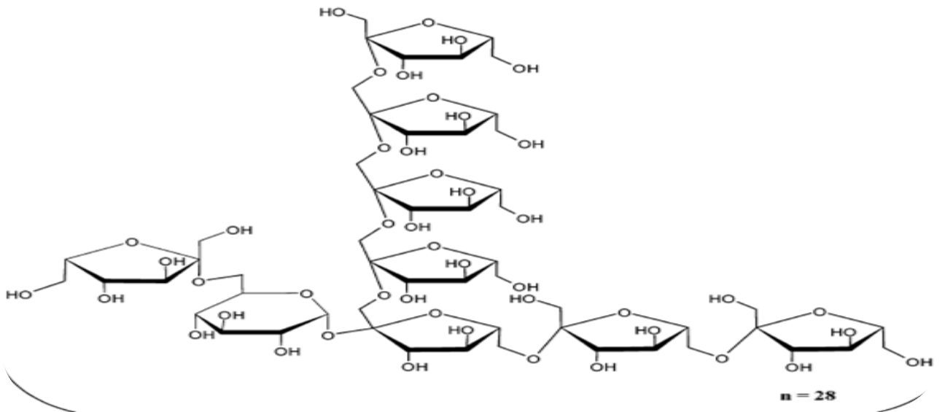
Powder/Liquid agave inulin and agave FOS
Agave Inulin is composed of branched and linear fructose chains, typically with a terminal glucose unit, connected with b-2,1 and b-2,6 linkages, and an average degree of polymerization (DP) between 25 and 34, while Chicory Inulin is a linear molecule with b-2,1 linkages.

Slide 10
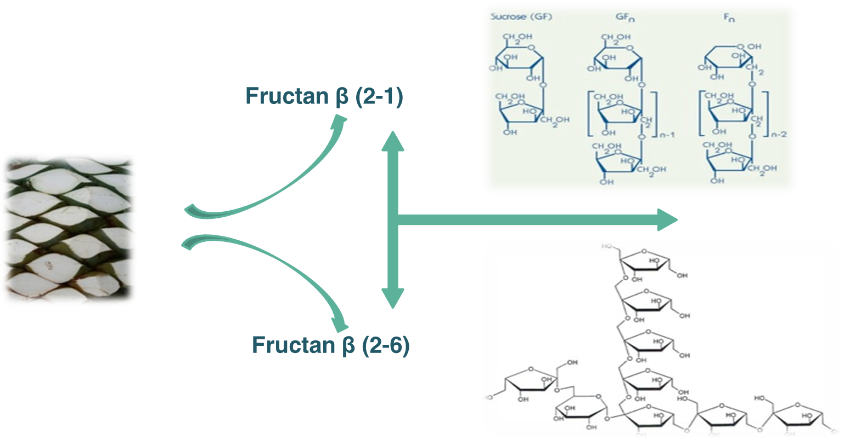
Chain size of agave inulin and agave FOS

Slide 11
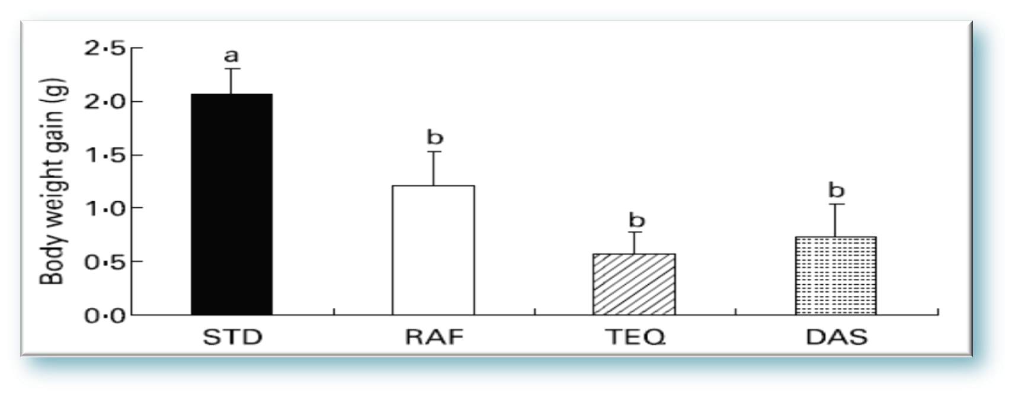
Agave Fructans in Obese Mice
(Source: A.L. Marquez-Aguirre, R.M.Camacho-Ruız, M.Arriaga-Alba, et al., Eﬀects of Agave tequilana fructans with diﬀerent degree o fpolymerization profiles on body weight, blood lipids and fecal Lactobacilli/Bifdobacteria in obese mice, Food Funct., 2013 )

Slide 12
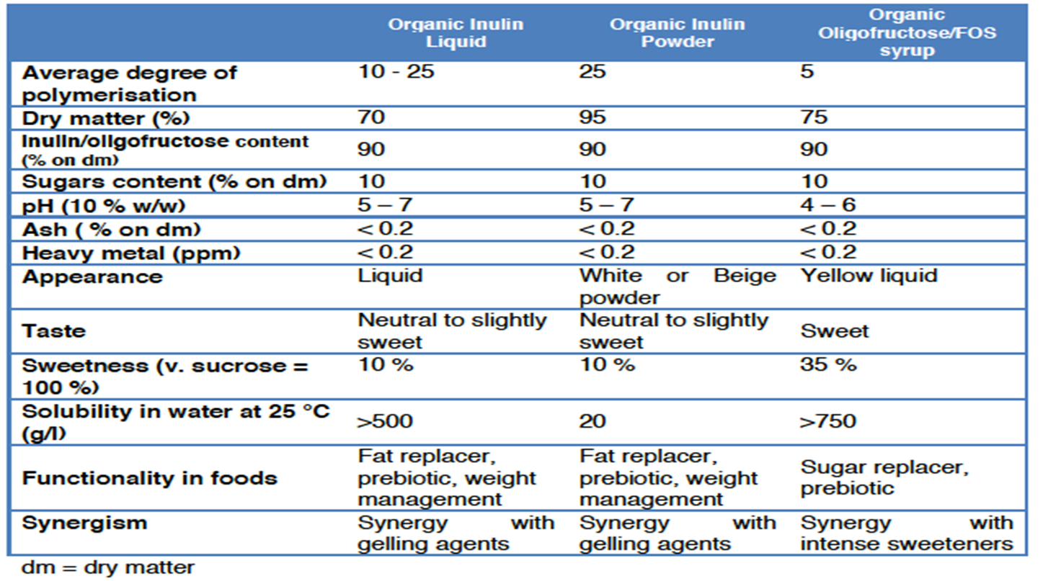
Physico-chemical characteristics of agave inulin and FOS

Slide 13
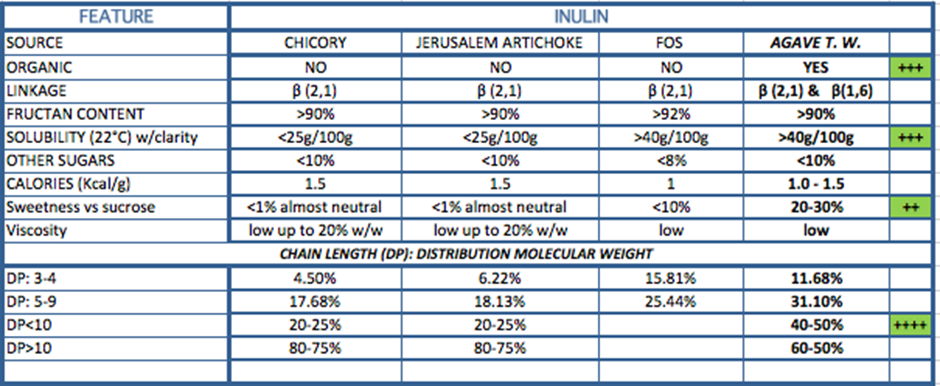
Inulin comparison chart

Slide 14
CONTACT US:
SALUTARY SA DE CV
www.salutary.com.mx
+52 (33)36122780
+52 (33)22673760
Ing. Francisco Zuñiga (CEO)
52-1-33-1025 8356 direccion@salutary.com.mx
Lic. Antonio Castro (International Sales Manager)
+1 (702) 482-1970 ventas2@salutary.com.mx

